Slide 1

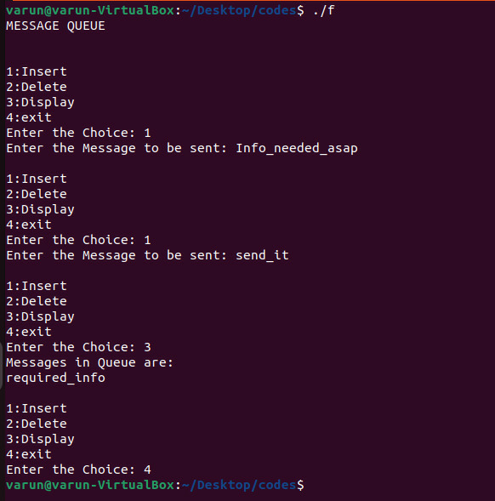
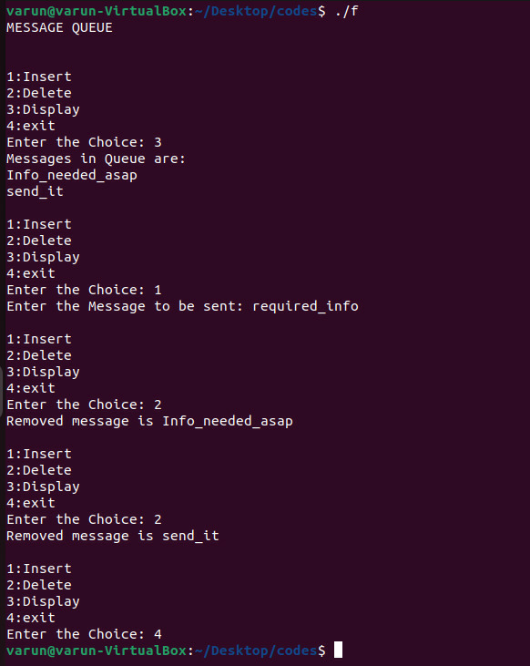
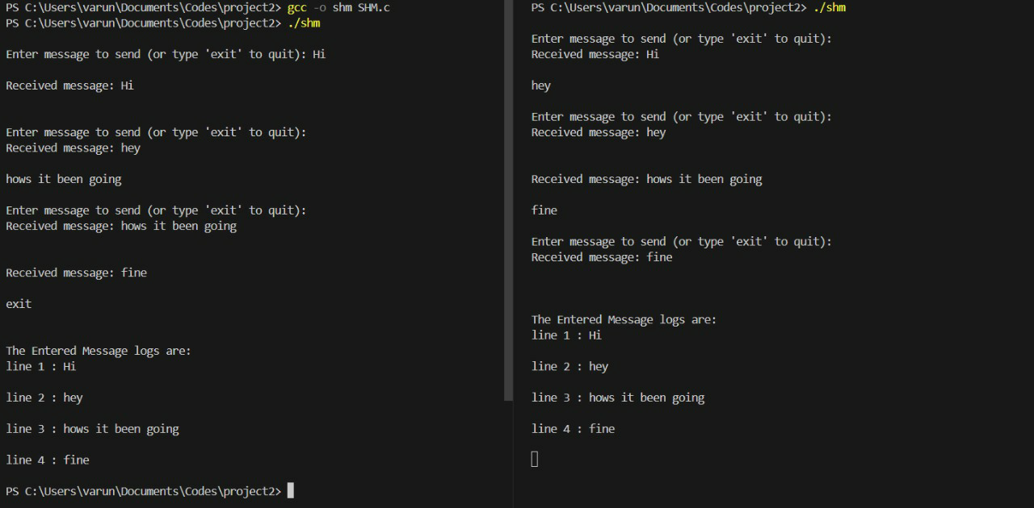
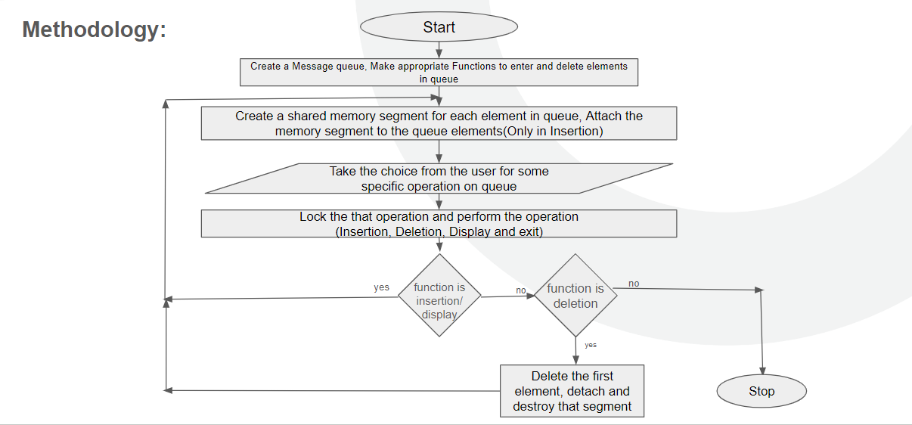
RV
College of Engineering
Title: Shared Memory Allocation in Ubuntu and Linux
Go, change the world
Department of Computer Science and Engineering
RV College Of Engineering , Bangalore - 560059
Guide Information:
Dr. Jyoti Shetty
Introduction:
Communication is the process of exchanging information and messages between two or more parties. One of the most common forms of communication is text-based, which involves using written symbols, such as letters, numbers, and punctuation, to convey meaning. Text-based communication can be done through various media, such as paper, email, SMS, chat, social media, and more. However, in order to communicate via texts, there needs to be a way to establish a connection between the sender and the receiver of the messages. This connection is usually facilitated by a device or a system that can transmit and receive texts over a network. Such devices or systems are called terminals.
System Architecture
Ubuntu: Linux Kernel: Ubuntu, like many other Linux distributions, relies on the Linux kernel as its core component. hardware and the software layers of the system. POSIX Compliance: Ubuntu adheres to POSIX standards, which define a set of operating system interfaces for compatibility across Unix-like systems. POSIX compliance ensures that Ubuntu supports a common set of APIs and utilities for inter-process communication, file operations, process management, and more, facilitating portability and interoperability with other POSIX-compliant systems.
Windows:
Windows Kernel: At the heart of the Windows operating system lies the Windows Kernel, which is part of the Windows NT architecture. The kernel provides core functionalities such as process and memory management, hardware abstraction, device drivers, and security features. It serves as the foundation upon which the entire operating system operates. User Mode and Kernel Mode: Windows employs a dual-mode operation, where software executes either in user mode or kernel mode
Methodology :
Choose a Communication Protocol: Select a communication protocol for exchanging text messages between the two terminals. Common choices include TCP/IP, UDP, HTTP, WebSocket, or MQTT, depending on your specific requirements.
Set Up Terminal Devices: Ensure that both terminal devices (computers, smartphones, IoT devices, etc.) are properly configured for communication. They should have network connectivity (Wi-Fi, cellular, or Ethernet) and the necessary software and hardware components.
Develop or Choose Messaging Software: Decide whether you will develop custom messaging software or use existing messaging platforms and apps (e.g., WhatsApp, Signal, or Slack). Developing custom software gives you more control but requires more effort.
Implement Authentication and Security: Establish a secure authentication mechanism to verify the identity of the terminals. You may use passwords, API keys, or more advanced methods like OAuth or JWT for authentication.
System Calls Used:
1. Shared Memory Initialization:
- shm_open(): Opens or creates a shared memory object named "/message_queue".
- ftruncate(): Sets the size of the shared memory object to the size of the struct queue.
- mmap(): Maps the shared memory object into the process's address space.
Algorithm of code:
2. Semaphore Initialization:
- sem_open(): Opens or creates a named semaphore with the name "/mutex" for mutual exclusion.
- sem_init(): Initializes the semaphore with the specified name and initial value (1).
- sem_unlink(): Removes the named semaphore after it's no longer needed.
3. Forking:
- fork(): Creates a child process. The child process handles user input and performs queue operations, while the parent process waits for the child to terminate.
OUTPUT:
Conclusion:
Throughout this journey, we will delve into the foundational concepts underpinning shared memory message queues, emphasizing their significance in modern computing paradigms. We will navigate through the principles of inter-process communication, explore the mechanics of shared memory management, and dissect the intricacies of system call invocation. Ultimately, our destination is the design and implementation of a robust shared memory message queue system, offering developers newfound avenues for optimizing communication between processes.
.
Reference:
[1] R. Basil Alothman, I. Ibraheem Saada and B. Salim Bazel Al-Brge, "Real-time text communication", Journal of Cases on Information Technology (JCIT), vol. 24, no. 2, pp. 1-18, 2022.
[2] Q. H. Makki, A. M. Abdalla and A. A. Tamimi, "Text-based communication between terminals", 2021 International Conference on Information Technology (ICIT), pp. 598-602, 2021.
Acknowledgement
We thank Principal and HoD, Department of Computer Science and Engineering, RVCE for the kind support received for completion of the project.
TEAM MEMBER:
VARUN A-1RV22CS226
T VINAY-1RV22CS215
YATHARTH YADAV-1RV22CS239

